Slide 1
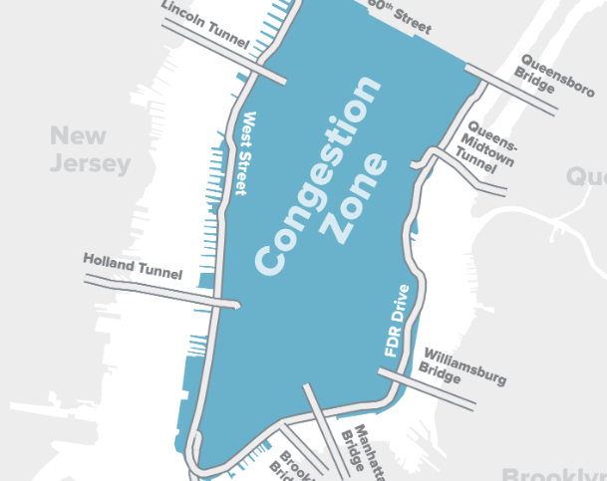
Project Overview
Objective: Examine the influence of congestion pricing on peak-hour travel from NJ to NYC.
Approach: Use multinomial logit and mixed logit models for behavior analysis.
Impact: Provide insights into policy design and urban traffic management strategies.

Slide 2
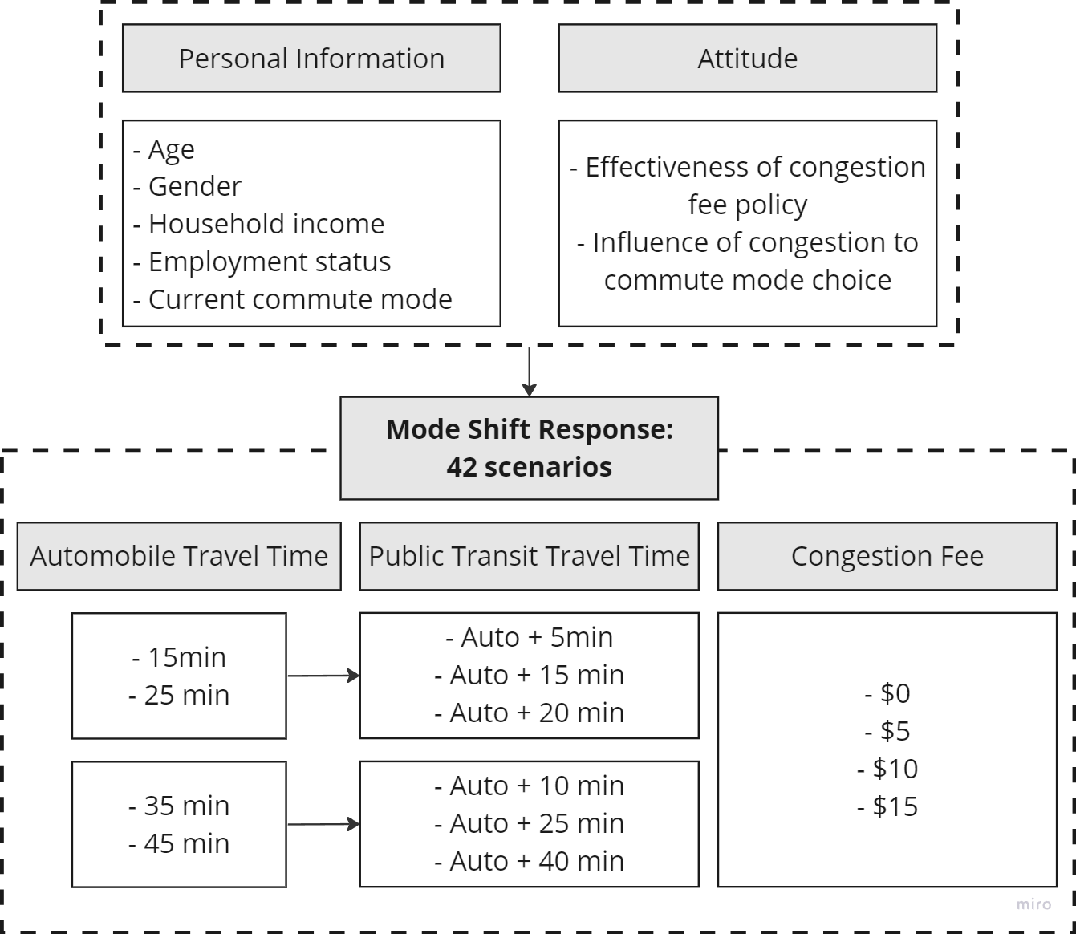
Survey Design
Demographics
Psychological
Mode choice at different
congestion fee
Travel time
Travel time difference
We got 153 respondents in Hudson, NJ

Slide 3
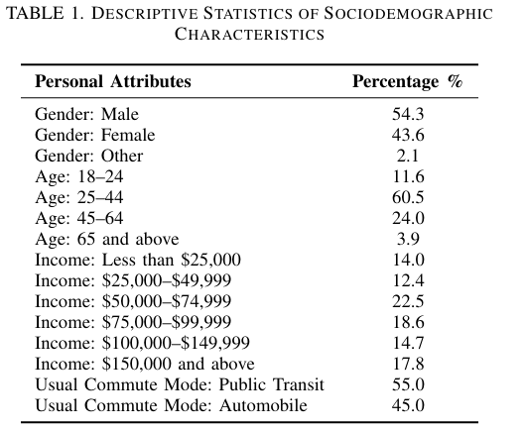
Survey Data Description

Slide 4
Methodology
Pooled Model
Multinomial Logit Model (MNL)
Mixed Logit Model (MXL)
Segmentation test for Commuters' Belief in Congestion fee Effectiveness (MNL & MXL)
Confident in Effectiveness
Skeptical in Effectiveness

Slide 5
Model
MNL
𝑈_{𝑖𝑛} = 𝜷_{𝑖} x_{𝑖𝑛} + 𝜀_{𝑖n} , where 𝜀_{𝑖n} i.i.d Gumbel.
Indifferent taste among population
MXL
𝑈_{i𝑛t} = 𝜷_{int} x_{𝑖𝑛t} + 𝜀_{int} , where 𝜀_{𝑖nt} i.i.d Gumbel , 𝜷_{int}~ f(𝜷|θ).
Model heterogeneity
Attributes
Alternative Specific: Travel Time, Travel Cost
Individual Specific: Age, Gender, Occupation(dummy), Income, Current commute mode
Iterate over all Individual Specific Attribute Combinations:
All coefficient p value < 0.1, Maximize McFadden's R Square
Mode Choice ~ Time + Cost |1+Income+CommuteMode| 0

Slide 6
Pooled Model Result
Table 1. Pooled model result
Variable | Pooled
 | MNL | MXL
Intercept: Auto | 0.642 | 0.272
Annual Household Income ($):Auto | 0.098* | 0.208*
Usual Commute Mode: Auto | -1.936*** | -3.855***
Travel Time | 0.043*** | 0.150***
Travel Cost | -0.087*** | -0.316***
sd.Time |  | 0.163***
sd.Cost |  | 0.129***
Log-Likelihood | -463.23 | -343.97
McFadden R^2 (LL_C) | 0.18404 | 0.39412
McFadden R^2 (LL_0) | 0.213 | 0.415
Higher Household Income
→ Automobile
Tend to maintain commute mode
Longer Travel Time
→ Automobile
Larger Travel Cost
→ Public Transit
MXL: Better fit. Significant individual heterogeneity
For MXL,
β_{Time} ∼N(0.15,0.0266), β_{Cost} ∼ N(-0.316,0.0166)

Slide 7
Segmentation Test Result
Skeptical group:
Income not significant
more sensitive to change in travel time and cost
Slightly better fit than pooled model
Table 2. Segmentation test result
Variable | More Belief in Effectiveness |  | Less Belief in Effectiveness
 | MNL | MXL | MNL | MXL
Intercept: CAR | 2.074** | 3.070** | 0.612 | 4.719**
Annual Household Income ($):CAR | 0.261** | 0.577**
Usual Commute Mode: CAR | -2.056*** | -3.499*** | -1.976*** | -5.318***
Travel Time | 0.049*** | 0.133*** | 0.067*** | 0.273***
Travel Cost | -0.054* | -0.172** | -0.143*** | -0.437***
sd.Time |  | 0.131*** |  | 0.191***
sd.Cost |  | 0.095** |  | 0.124**
Log-Likelihood | -167.06 | -130.45 | -171.23 | -122.46
McFadden R^2 (LL_C) | 0.19552 | 0.37183 | 0.25135 | 0.46456
McFadden R^2 (LL_0) | 0.716 | 0.778 | 0.709 | 0.792
Likelihood Ratio Test:
Test Statistic = 182.1157
Dof = 7
P value < 0.01
→ Reasonable Segmentation

Slide 8
Sensitivity of Cost
Elasticity of probability of choosing Automobile to Automobile Travel Cost for :
e_{Pn(Auto)},x_{Auto,Cost,n} = β_{Auto,Cost}x_{Auto,Cost,n}(1-P_{n}(Auto))
Confident in Effectiveness Group: Elasticity = -2.25.
Congestion fee increasing 1% → loosing 2.25% probability of choosing Auto
Skeptical in Effectiveness Group: Elasticity = -5.11.
Congestion fee increasing 1% → loosing 5.11% probability of choosing Auto
More sensitive to cost change

Slide 9

Next Steps
Predict the drop in NJ-NY commuting automobile trips under different congestion pricing schemes

Slide 10
Reference
[1] Regional Plan Association (RPA). (n.d.). Congestion Pricing in NYC. Accessed February 9, 2024, from https://rpa.org/work/reports/congestion-pricing-in-nyc
[2] HNTB. (n.d.). Fix NYC Report. Accessed February 9, 2024, from https://www.hntb.com/fix-nyc-report/
[3] He, B. Y., Zhou, J., Ma, Z., Chow, J. Y. J., & Ozbay, K. (2020). Evaluation of city-scale built environment policies in New York City with an emerging-mobility-accessible synthetic population. Transportation Research Part A: Policy and Practice, 141, 444-467. https://doi.org/10.1016/j.tra.2020.10.006
[4] (2021). A validated multi-agent simulation test bed to evaluate congestion pricing policies on population segments by time-of-day in New York City. Transport Policy, 101, 145-161. https://doi.org/10.1016/j.tranpol.2020.12.011
[5] Cai, Y., Ong, G. P., & Meng, Q. (2023). Understanding bike-sharing as a commute mode in Singapore: An agent-based simulation approach. Transportation Research Part D: Transport and Environment, 122, 103859. https://doi.org/10.1016/j.trd.2023.103859
[6] Cipriani, E., Mannini, L., Montemarani, B., Nigro, M., & Petrelli, M. (2019). Congestion pricing policies: Design and assessment for the city of Rome, Italy. Transport Policy, 80, 127-135. https://doi.org/10.1016/j.tranpol.2018.10.004

